Slide 1
Artificial Intelligence in Africa
Opportunities & Challenges
Bunmi Banjo, Managing Director, Kuvora Inc.
November 21, 2019
2019 World Science Forum presentation
Budapest
www.kuvora.com

Slide 2
State of Play
www.kuvora.com
Artificial Intelligence in Africa

Slide 3
State of play
May 2019 Microsoft announced a US$100 million investment in its Africa Development Centres (ADC), with initial software development sites slated to open in Nairobi, Kenya and Lagos, Nigeria later this year.
In late 2013, IBM Research opened its first African office in Nairobi; it added another in Johannesburg, South Africa, in 2016
Earlier this year Google opened a new AI lab in Accra, Ghana.
2020 ICLR, a major AI research conference, will host its event in Addis Ababa, Ethiopia.” to pursue fundamental and cutting-edge research.”
Has announced plans for two data center's in Africa
Data Science Africa
2018 Amazon Web Services announced it would open its first African data centre in 2020
In 2013, a local group of industry practitioners and researchers began Data Science Africa, an annual workshop for sharing resources and ideas
2017, another group formed the organization Deep Learning Indaba, which now has chapters in 27 of the continent’s 54 countries.
AIMS in partnership with Google & Facebook launched the African masters in machine intelligence in 2018
www.kuvora.com
Artificial Intelligence in Africa

Slide 4
State of play
Fastest urbanizing region in the world
Rapid population Growth
Infrastructure improvements
Early stage investment funding
Increase in smart phone use
Energy & Talent of Young People
www.kuvora.com
Artificial Intelligence in Africa
Notes:
Factors creating a fertile environment for Africa’s emerging AI industry. In addition to the well known challenges across the region, current technological advancements are occurring against a backdrop of energetic youth, fast growing population and rapid urbanization
Fastest urbanizing region in the world
Rapid population Growth. The continent’s population of roughly 1.1 billion is expected to double by 2050
Infrastructure improvements - especially in power supply and high-speed internet
More early-stage investment funding
Increase in smartphone use
Energy & Talent of Young People

Slide 5
Pockets of success
www.kuvora.com
Artificial Intelligence in Africa

Slide 6
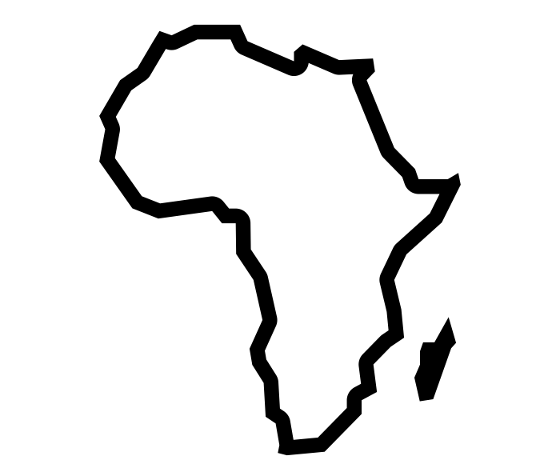
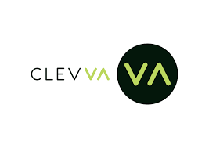
Pockets of success
Countries
Sectors
Companies & Startups
Countries where most progress is being made.
Specific sectors being impacted.
Companies and startups which are successfully using AI to address challenges.
Egypt
Healthcare
Ghana
Nigeria
Kenya
Finance
Logistics/Transportation
South Africa
www.kuvora.com
Artificial Intelligence in Africa
Notes:
Several leaps are being made in some countries especially Ghana, Nigeria, South Africa, Kenya and Egypt
Access to Finance: Mobile-lending platforms such as Carbon and Kudi are using machine learning to evaluate credit applications and provide access to finance
Retail: Some fashion retailers now rely on algorithms to predict the next season’s top sellers
Human Capital Management: Kenyan ride-hailing app Little has implemented AI to assess driver performance.
Start-ups in Ghana and Nigeria are addressing doctor shortages and the lack of medical access for rural Africans. They have begun to use AI to empower doctors and leverage growing mobile phone ownership as a vehicle for collecting data, improving administrative efficiency, and to expand treatment coverage.
In both Kenya and Nigeria, AI focused start-ups have begun working on agricultural planning, reducing financial transaction costs, and improving public transportation access and efficiency.
Education has also been a focus of start-ups like M-Shule and Tuteria, which provide accessible and extensive training and learning platforms to help teachers in the classroom.

Slide 7
Causes for Concern
www.kuvora.com
Artificial Intelligence in Africa

Slide 8
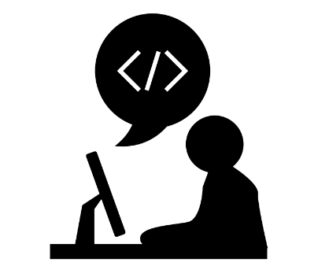
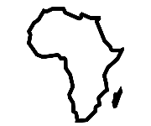
Causes for concern
Market challenges
Limited
number of African researchers and AI talent
>60%
of Africans not online
Underrepresentation
of Africa and Africans globally
Education systems will need to adapt quickly
In Africa, educational institutions have only recently begun to narrow the gap
Recruiting AI talent is an ongoing pressure point: The right data scientists
Broadband coverage will need to expand rapidly, specifically in rural areas in order for all citizens and businesses to reap the benefit
In 2018, more than 100 researchers were denied visas to enter Canada for NeurIPS.
Ensuring a deeper, broader, and more accessible pool of data is available will also be key to enable researchers, developers, and users to drive AI.
]
]
www.kuvora.com
Artificial Intelligence in Africa
Notes:
Market Challenges:
Building an AI-powered start-up in Africa comes with a unique set of challenges not experienced by entrepreneurs in Silicon Valley, particularly in terms of raising capital, human resources and market receptiveness.
Limited number of African researchers and AI talent
Education systems will need to adapt quickly, and new frameworks need to be created for workers and citizens to develop the skills they need to thrive.
Virtually every university in Europe and North America has responded to the challenges and opportunities of data science by establishing new institutes, departments and degree programmes in the field. In Africa, however, educational institutions have only recently begun to narrow the gap
Recruiting AI talent is an ongoing pressure point: Super-smart data scientists are critical for the success of AI companies; yet it is a skill that is in short supply on the African continent.
>60% of Africans not online
Broadband coverage will need to expand rapidly — specifically in rural areas — in order for all citizens and businesses to reap the benefits.
Underrepresentation of Africa and Africans globally
People - In 2018, more than 100 researchers were denied visas to enter Canada for NeurIPS.
Data - Ensuring a deeper, broader, and more accessible pool of data is available will also be key to enable researchers, developers, and users to drive AI.

Slide 9
Causes for concern
Regulatory & Structural Concerns
Negative AI
AI Integration
Legal Frameworks
Weaker governance structures, transitioning democratic norms, and highly salient ethnic and religious divisions will likely struggle to minimize the damage associated with negative AI.
Laws and legal frameworks not yet addressing AI.
Little to no integration of AI into existing structures and plans.
Rules of engagement not set
Ethical Implications
The biggest data capturers in Africa are multinationals from the US and China.
Ethical implications regarding the fair, secure, and inclusive use of AI applications.
www.kuvora.com
Artificial Intelligence in Africa
Notes:
Negative AI: Impact of Negative AI might be larger: Weaker governance structures, transitioning democratic norms, and highly salient ethnic and religious divisions will likely struggle to minimize the damage associated with negative AI.
AI Integration: Little to no integration of AI into existing structures and plans.
Legal Frameworks Lacking: Laws and legal frameworks not yet addressing AI e.g. With the help of China, the Zimbabwean government has begun collecting individuals’ facial imagery to be used by existing monitoring and facial recognition applications. These applications have human rights advocates worried about potential misuse once the system comes online.
Rules of Engagement Not Set: The biggest data capturers in Africa are United States & China multinationals. American companies, including Google, Microsoft, Amazon, Apple, and Netflix, make up 11 of Indaba’s 34 sponsors.
Ethical Implications: Ethical implications regarding the fair, secure, and inclusive use of AI applications also must be addressed through collaboration and engagement to ensure AI systems earn trust.

Slide 10
Realizing the Potential
www.kuvora.com
Artificial Intelligence in Africa

Slide 11
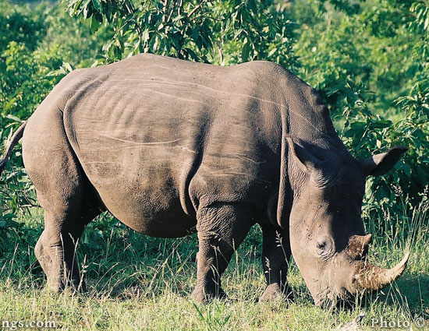
Realizing the potential
Agriculture
Healthcare
Public Service
Financial Services
Protect endangered species
Financial services will be more secure and reach more citizens who need them, expanding access.
Public services will be more efficient and more responsive to citizens, enhancing impact.
Artificial Intelligence will help reduce loss of important wildlife.
Agriculture will be done more efficiently and effectively, raising yields
Healthcare will be better tailored, higher quality, and more accessible, improving outcomes.
www.kuvora.com
Artificial Intelligence in Africa

Slide 12
Thank you
bb@kuvora.com.
@bunmibanjo
bunmibanjo
www.kuvora.com
Artificial Intelligence in Africa

