Slide 1
Dr. France A. Córdova Director National Science Foundation

Slide 2
Key Points
The responsible and ethical conduct of research inspires credible science, a collaborative research culture, and the trust of the public.
Promoting the responsible and ethical conduct of research is central to the fulfillment of NSF’s mission.
The US White House Office of Science and Technology Policy (OSTP) is leading a coordinated effort across US science agencies to support the integrity of America’s research enterprise.

Slide 3
What is the Responsible and Ethical Conduct of Research?
Generate and disseminate knowledge with rigor and integrity
Conduct peer review with the highest ethical standards
Protect intellectual property
Treat students and colleagues fairly and with respect

Slide 4
Why is Responsible and Ethical Conduct Important?
Enables sound research results
Promotes best practices
Considers impact of research on people and society
Creates inclusive environments
Strengthens public trust

Slide 5
Promoting the Responsible & Ethical Conduct of Research
Responsible and Ethical Science
Identify Priorities
and Role for NSF
Fund
Basic
Research
Create
Policy
+
Engage the Public

Slide 6
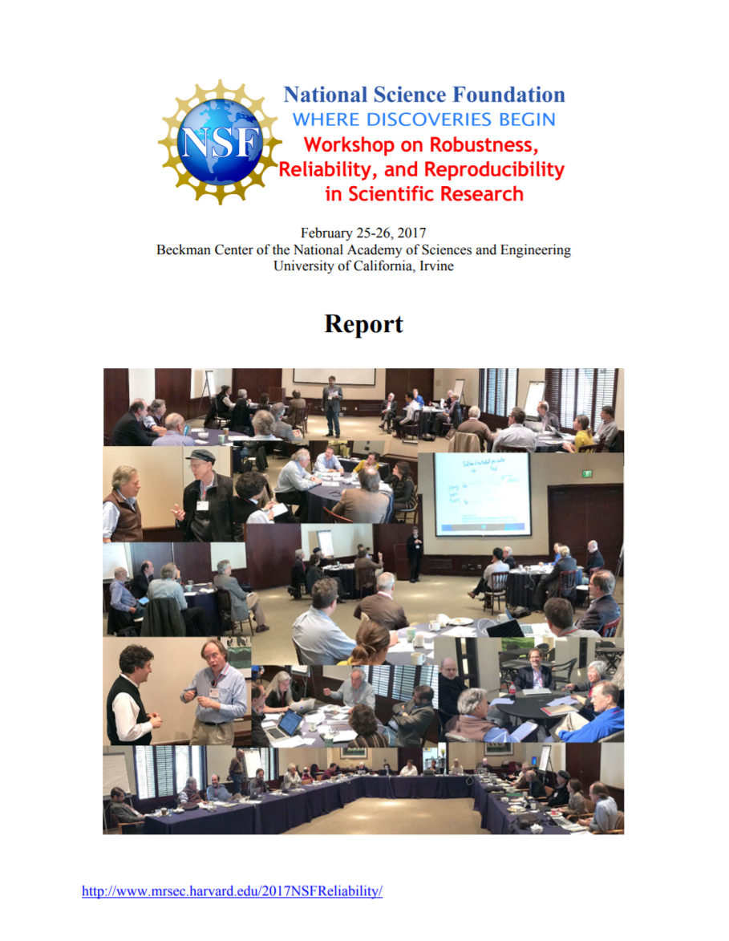
Identifying Priorities

Slide 7
Investing in Research
AI and Society
Fairness in AI with
Amazon
Fairness, Ethics, Accountability, and Transparency for Research

Slide 8
Training an Ethical Workforce
Computer Science for All (CSforAll)
Goal: provide access to rigorous, engaging CS education for all K-12 students in the USA
New College Board Advanced Placement® exam launched; includes modules for teaching the ethical use of technology
Computing in Undergraduate Education
Integrating computing with other fields as a key tool to solve challenging problems
Cultivating networked communities that can work together to improve CS higher education
Encouraging integrating the study of ethics

Slide 9
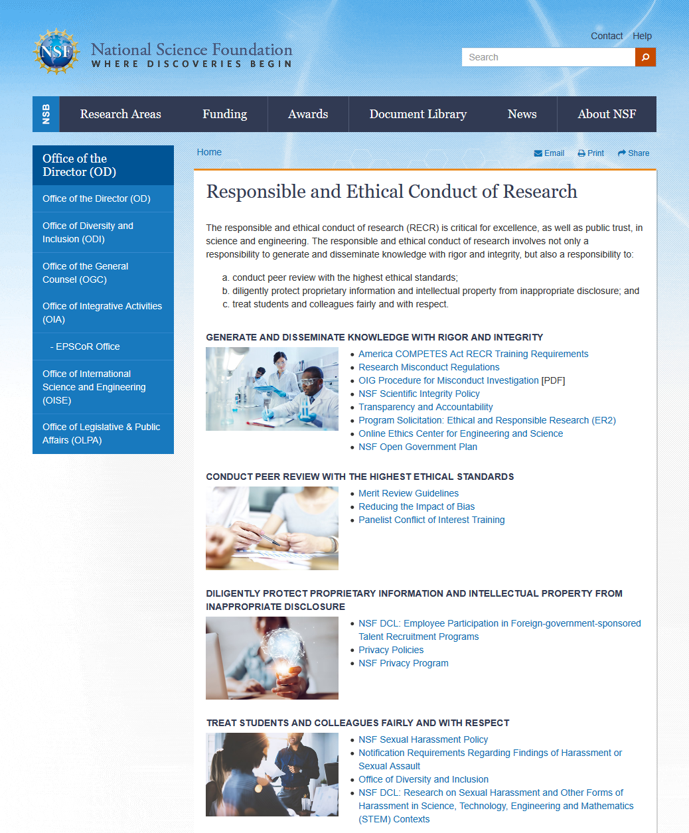
Communicating Through NSF.gov

Slide 10
“Unleashing American discovery and innovation means providing the environment that allows our scientists, engineers, inventors, and entrepreneurs to do what they do best – explore, discover, and be creative.”
Dr. Kelvin K. Droegemeier
Director, The White House Office of Science and Technology Policy

Slide 11
U.S. National Science & Technology Council
NSTC
S&T Enterprise
Environment
Homeland and National Security
Science
STEM Education
Technology
Artificial Intelligence
Research Environment
National Science and Technology Council (NSTC)
Coordinates US science and technology policy across the federal government

Slide 12
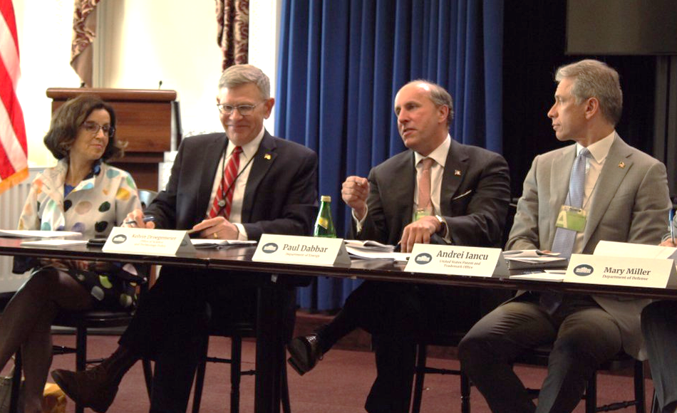
NSTC Joint Committee on Research Environments (JCORE)
Launched in May 2019
Co-chaired by White House Office of Science & Technology Policy and several US science agencies
Three overall objectives
Elevate research environment issues
Convene and lead by example
Engage with external community

Slide 13
JCORE has Four Subcommittees
Coordinating Administrative Requirements for Research
Safe & Inclusive Research Environments
Rigor & Integrity in Research
Research Security
NSF co-chairs all four subcommittees

Slide 14
Working with International Partners

Slide 15
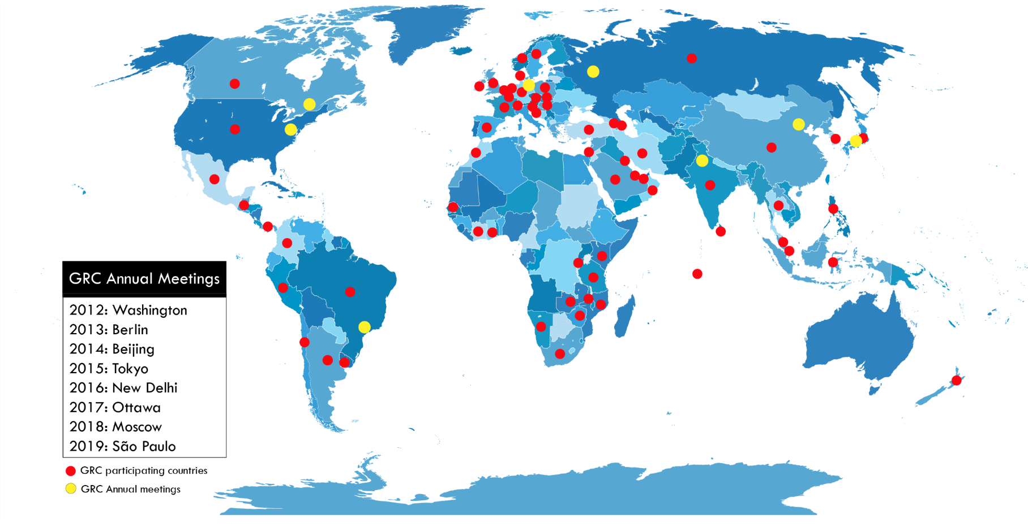
Global Research Council

Slide 16
OECD Principles for Trustworthy AI
Stakeholders
Civil society, the technical and academic communities, industry, governments, organized labor as well as individuals (as workers or data subjects)
Principles
Inclusive and sustainable growth and well-being
Human-centered values and fairness
Transparency and explainability
Robustness and safety
Accountability

Slide 17
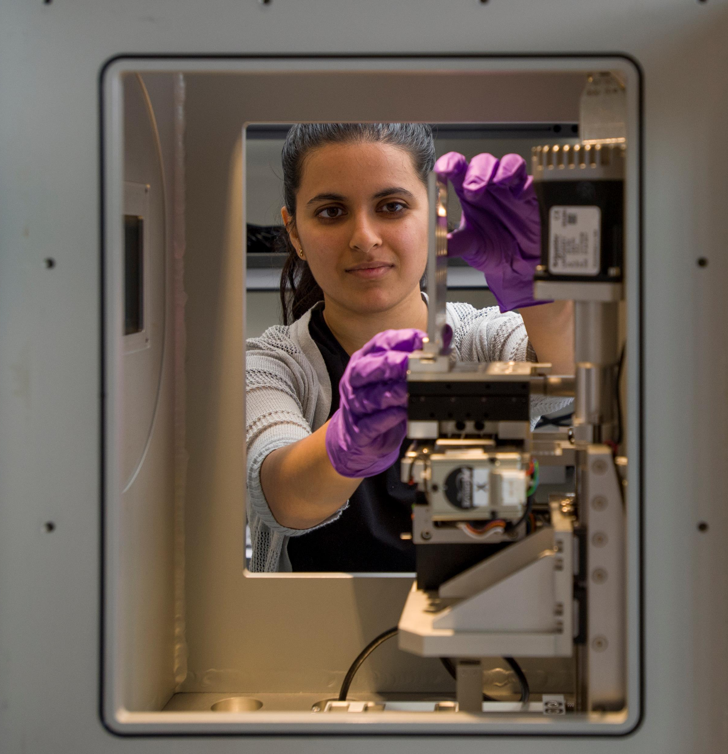
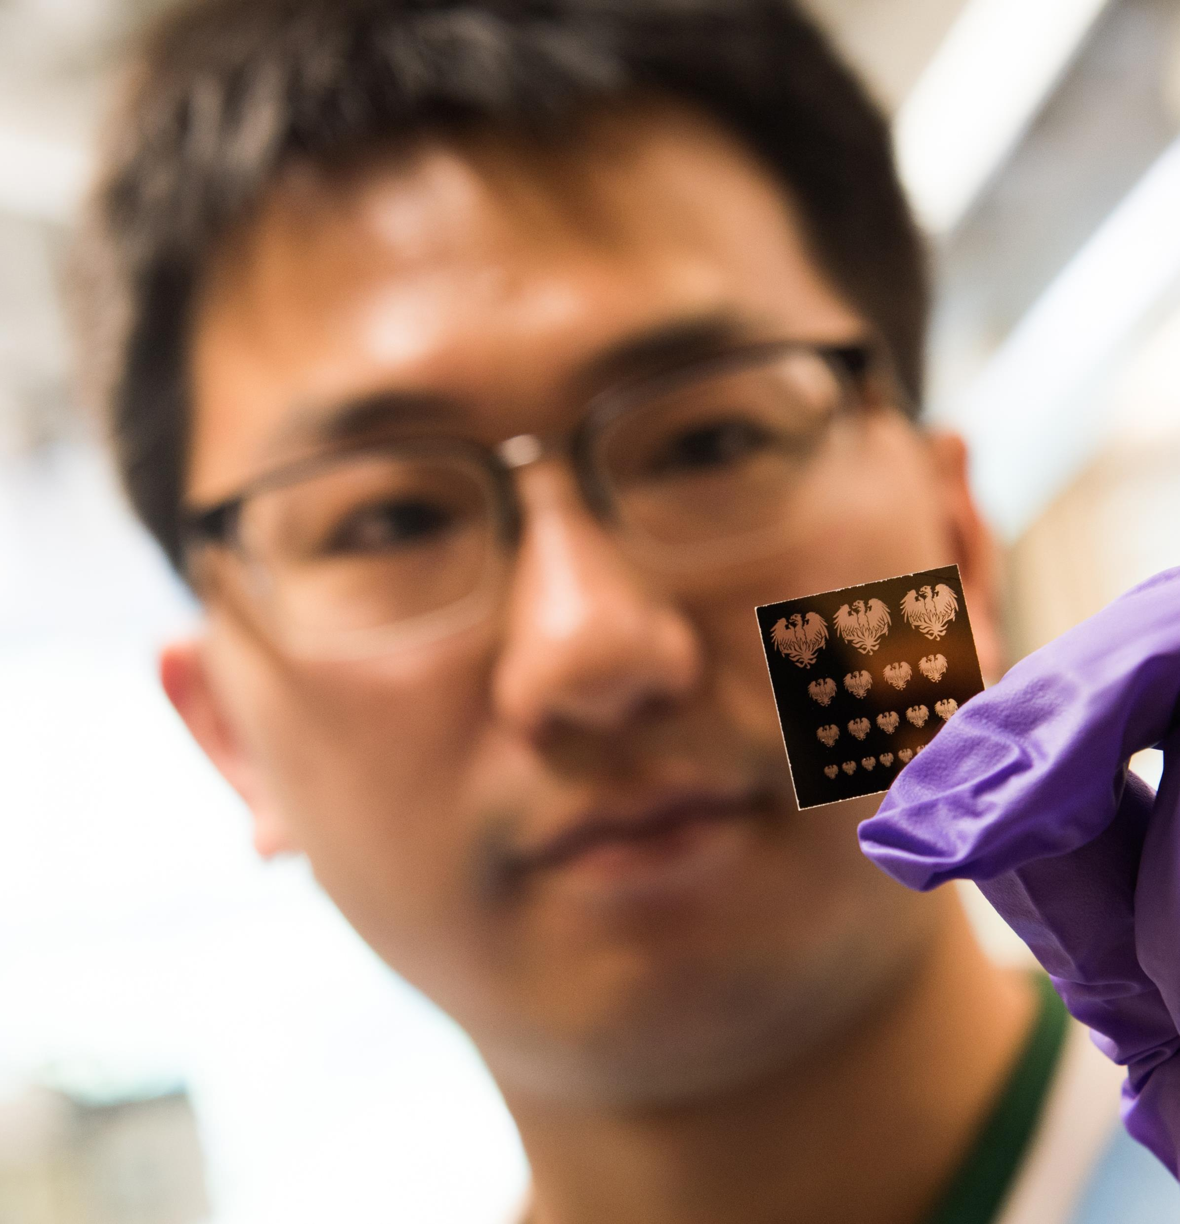
A New Landscape for Research

Slide 18
Dr. France A. Córdova Director National Science Foundation

