Slide 1
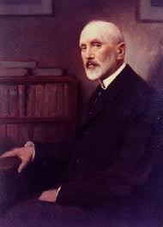



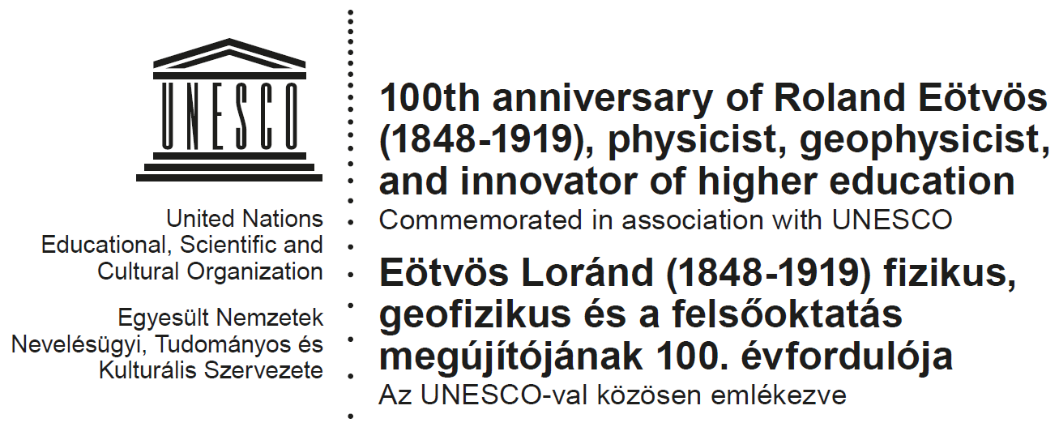


The Eötvös Experiment
in its Historic Context
Jenő Sólyom
MTA, Wigner RC and ELTE
Budapest
20 November 2019

Slide 2
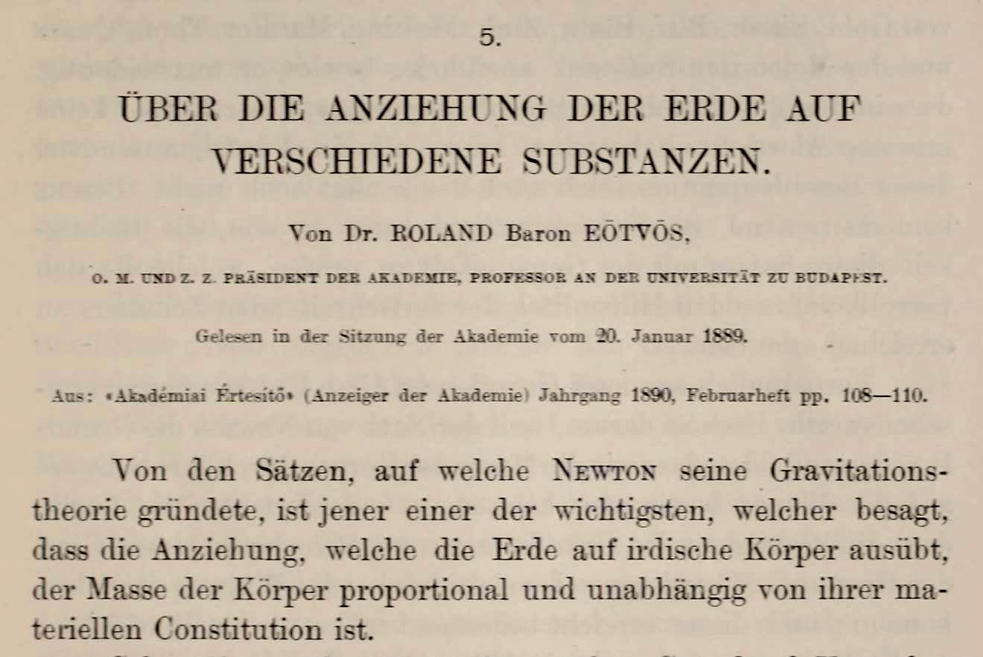
The first paper by Roland Eötvös on the proportionality of the inertial and gravitational mass

Slide 3
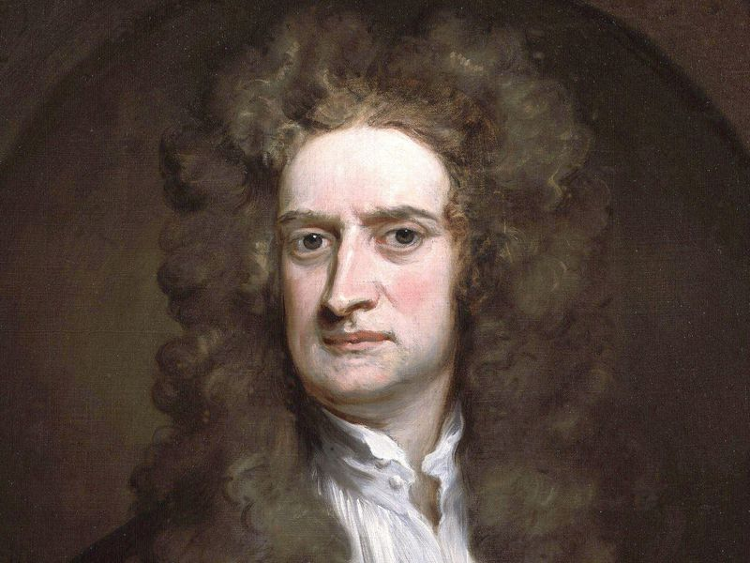
The two masses in classical (Newtonian) physics
1. Gravitation:
F = G m₁m₂/R²
Between a body and the Earth:
F = m_{g} G M/R²
2. Newton’s second law of dynamics:
F = m_{t} a
The ratio of the two masses is universal, hence the acceleration of free fall does not depend on the material composition.
a = m_{g}/m_{t} G M/R²

Slide 4
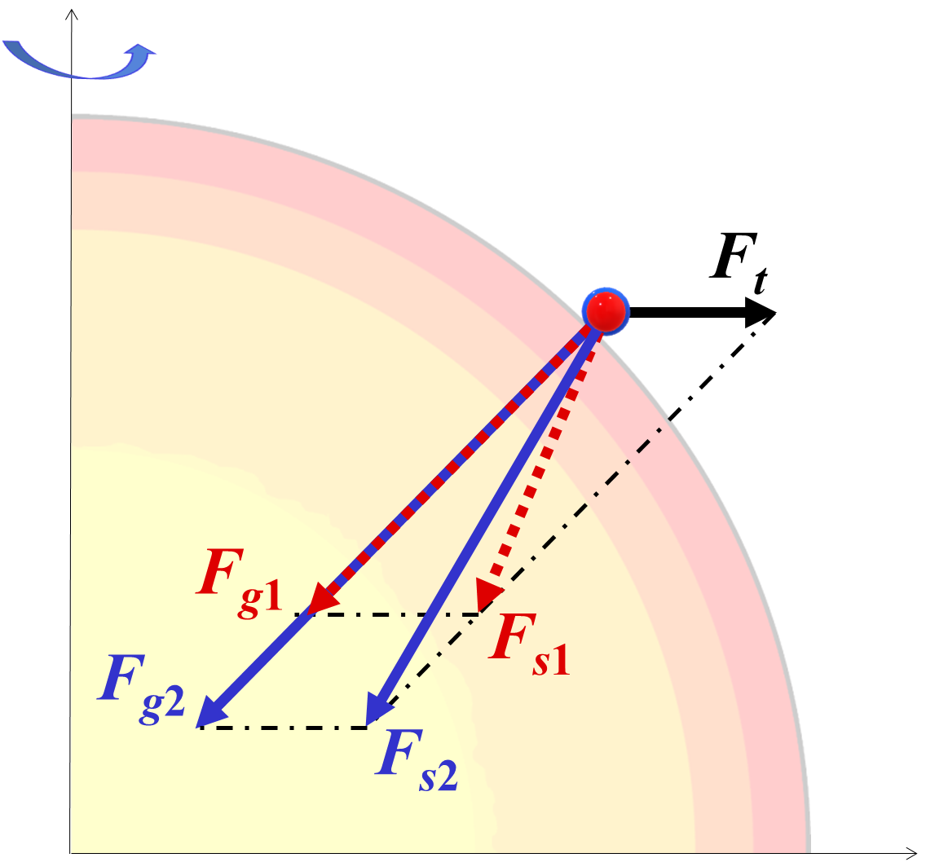
Eötvös’s method
The weight of a body on the Earth is composed of two terms:
The attraction by the Earth is proportional to m_{g}.
The centrifugal force due to the rotation of the Earth is proportional to m_{t} .
If the ratio of m_{g} and m_{t} is not a universal quantity, the weight vector would point in different directions, causing a finite momentum and a rotation of the torsion balance.

Slide 5
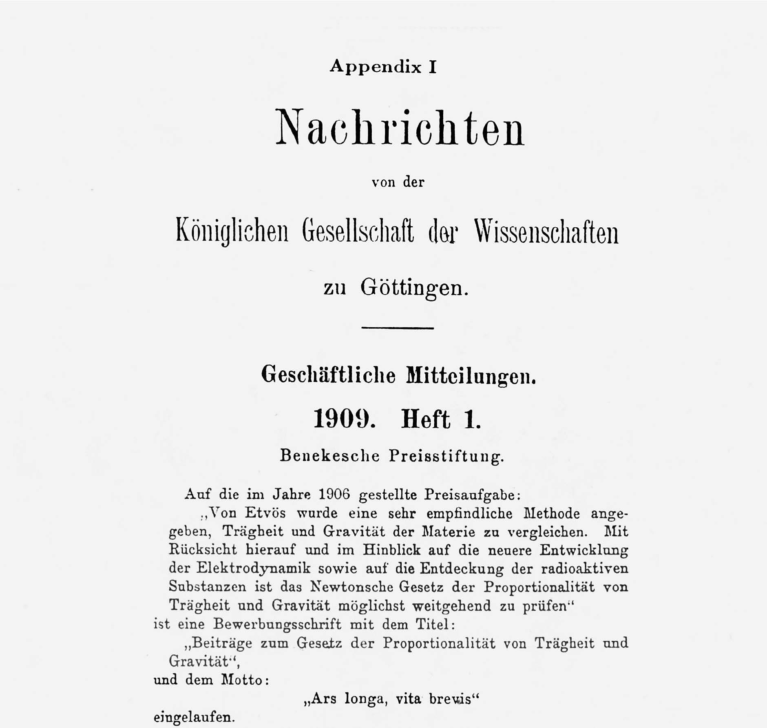
Report of the jury of the Beneke Prize Foundation

Slide 6
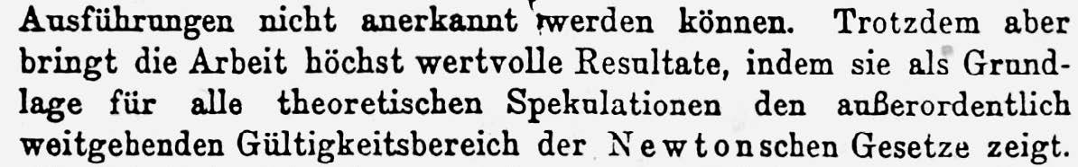
Excerpt from the conclusions of the report
Nevertheless, the experiments yielded extremely valuable results which can serve as a basis for further theoretical considerations concerning the extraordinarily extensive validity of Newton’s theorem.

Slide 7
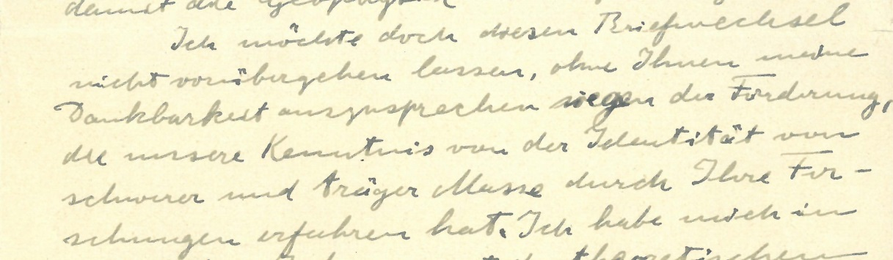
Letter by Albert Einstein to Eötvös on 30 January 1918.
I do not want to let this exchange of letters pass, though without expressing to you my gratitude for the advancement that our knowledge of the identity of gravitational and inertial mass has made through your investigations.
Mining and Geological Survey of Hungary,
Magyar Bányászati és Földtani Szolgálat, Eötvös Loránd Emlékgyűjtemény

Slide 8
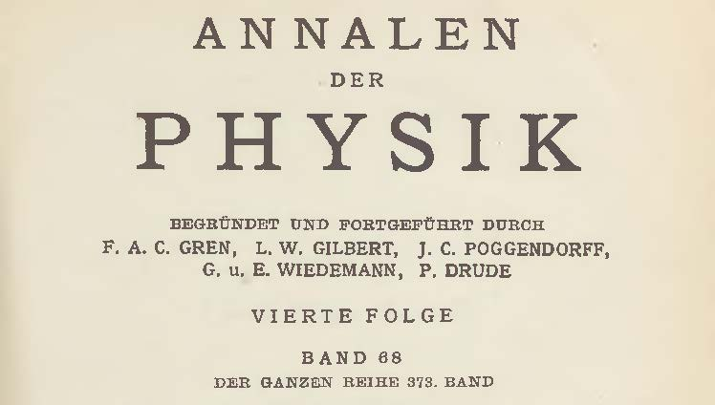
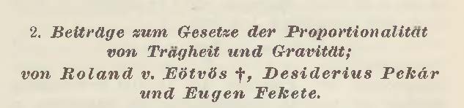
The paper published in 1922 by Eötvös, Pekár and Fekete

Slide 9
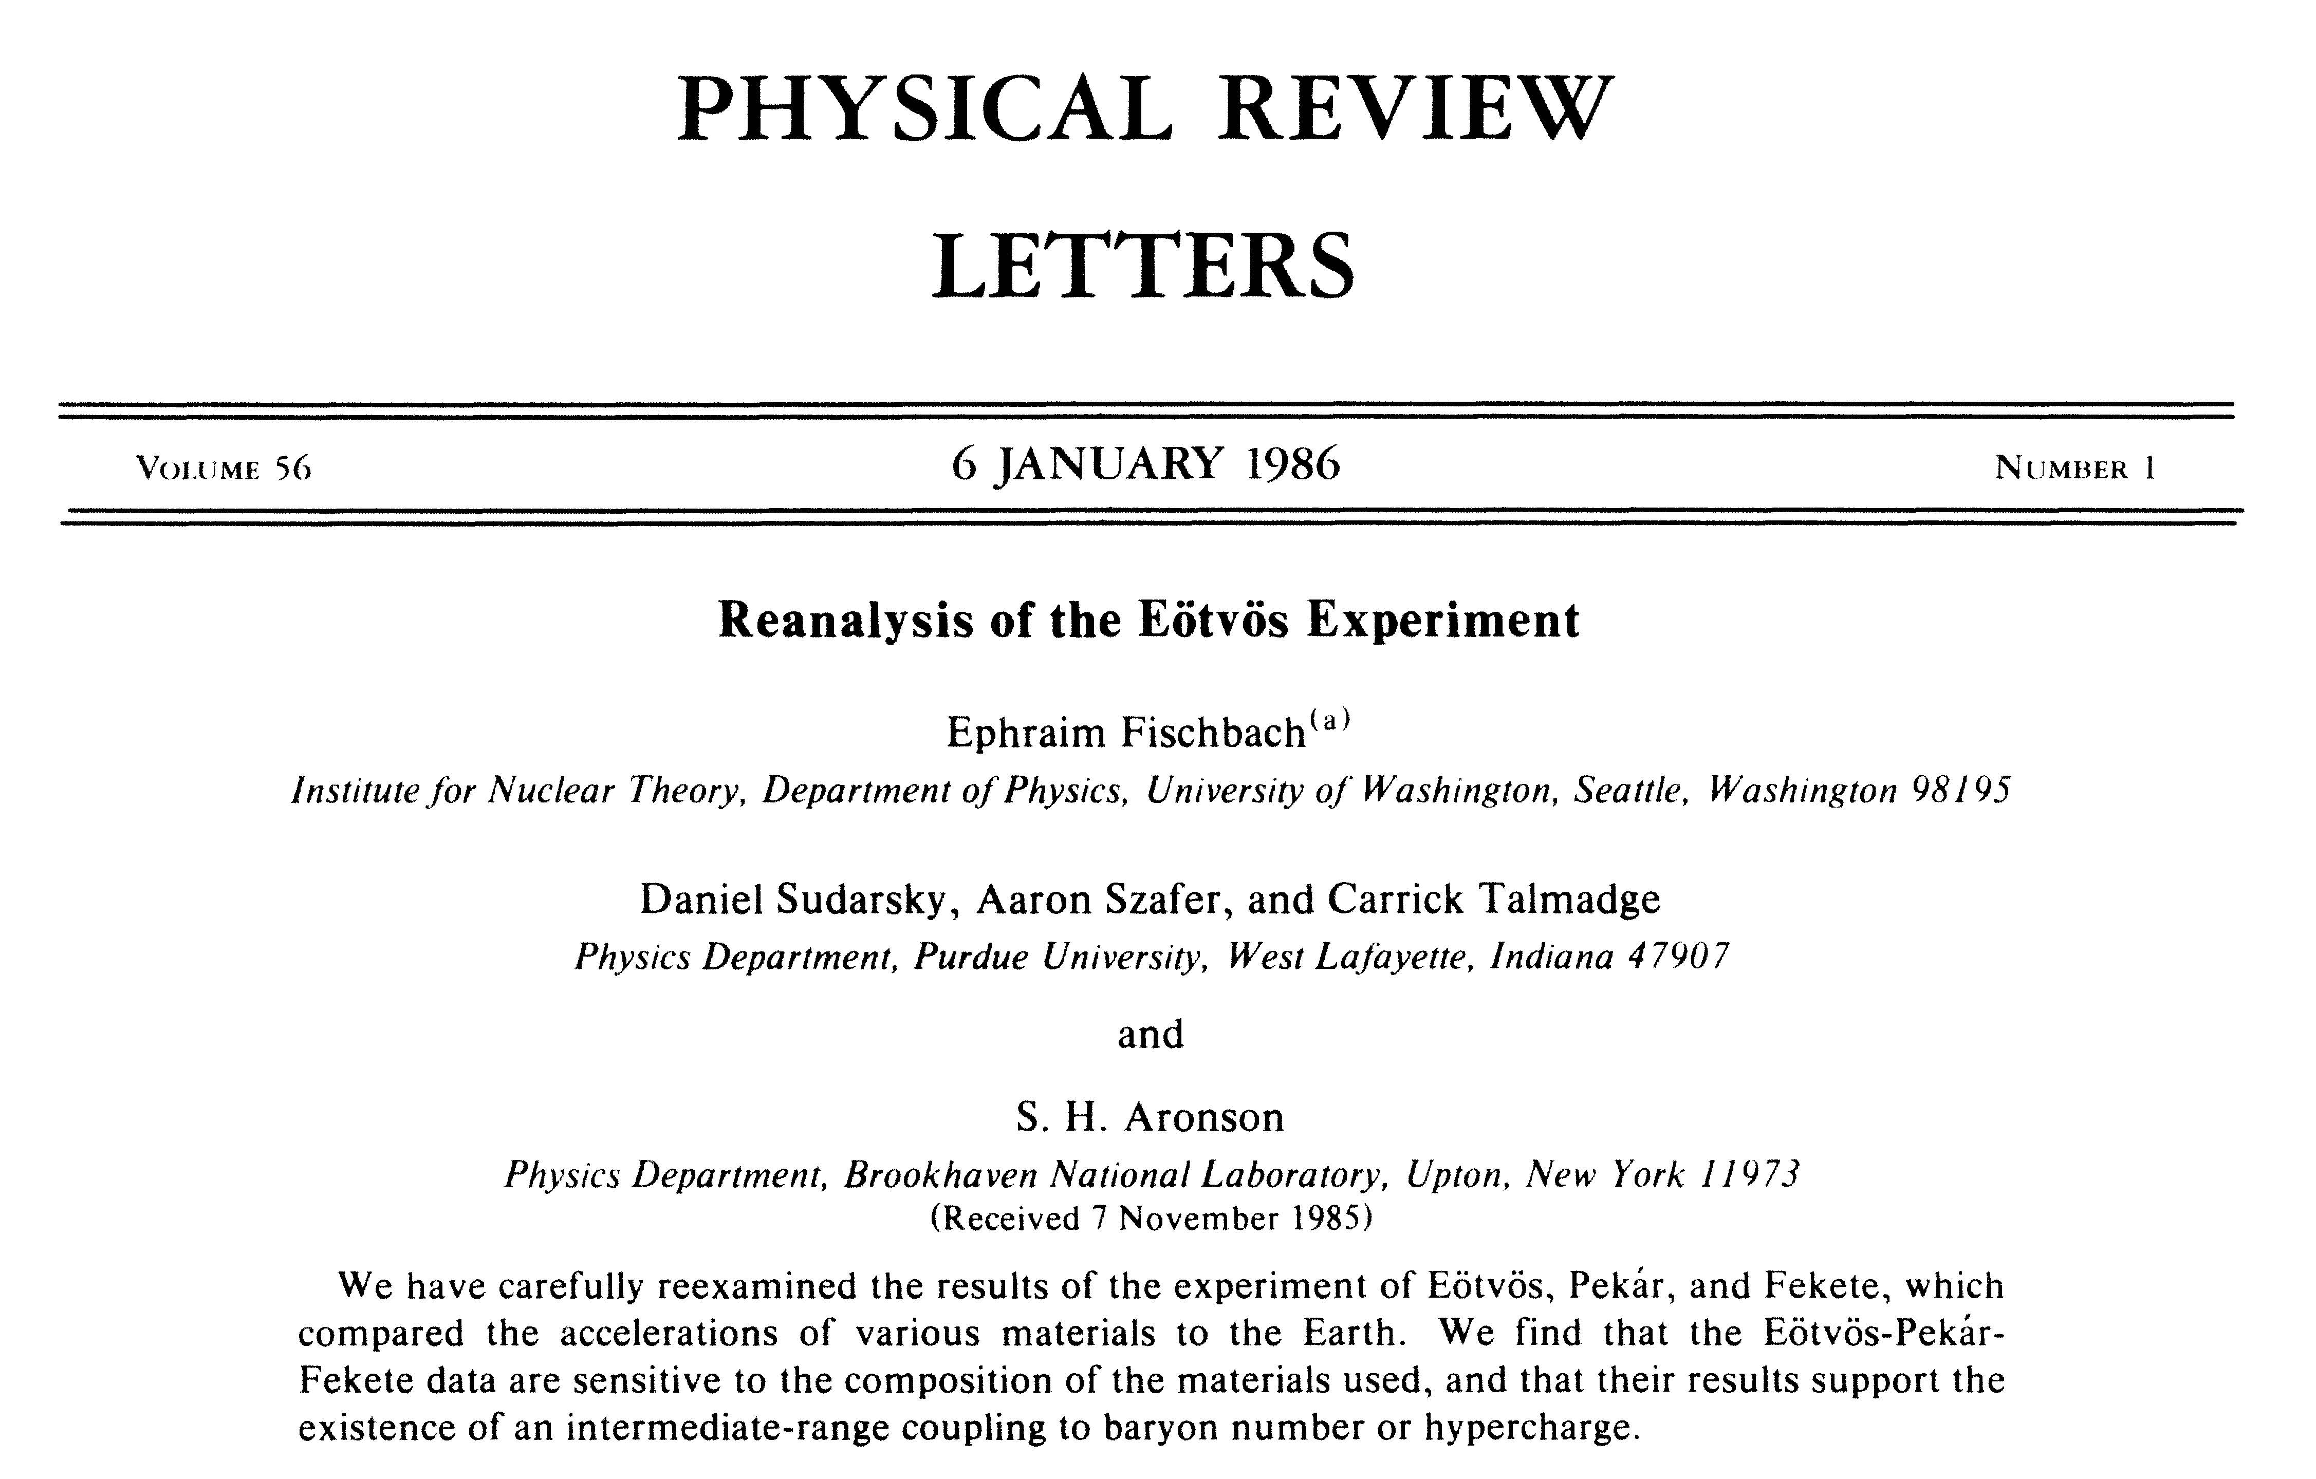
The paper by Fischbach et al. in 1986

Slide 10
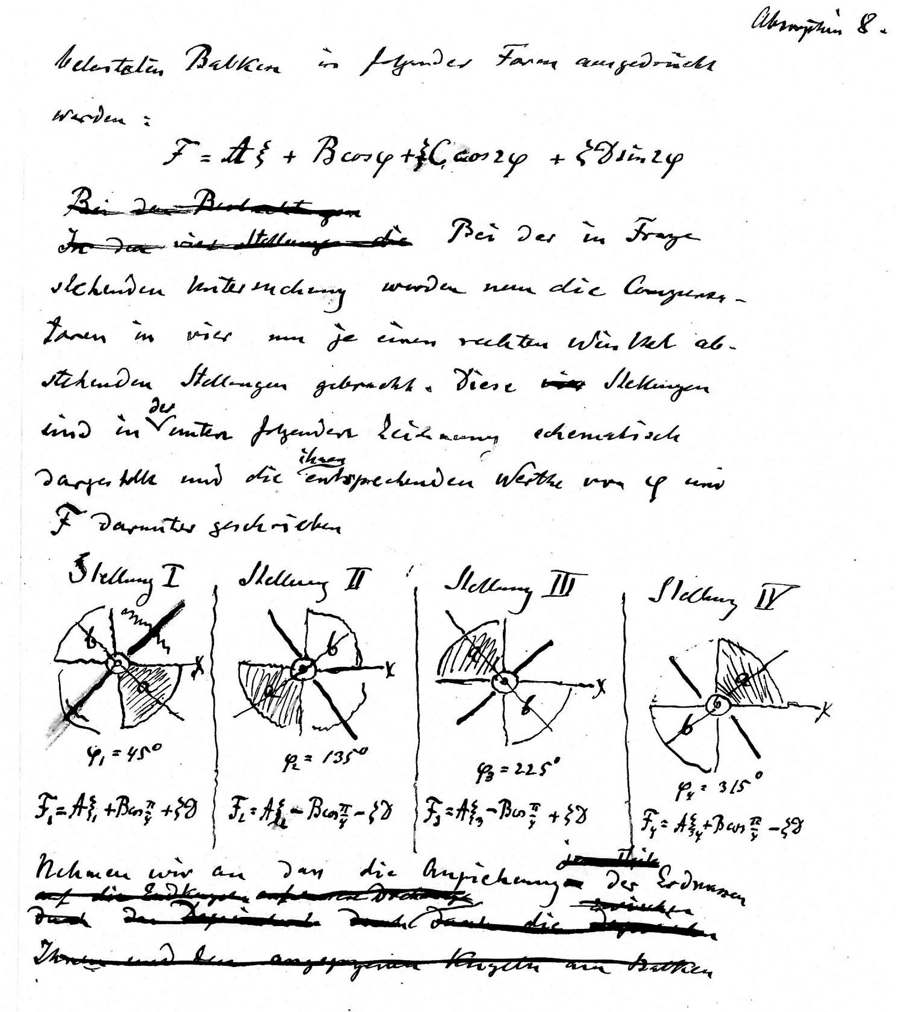
A page from the manuscript (autograph) prepared by Eötvös
in 1908

Slide 11
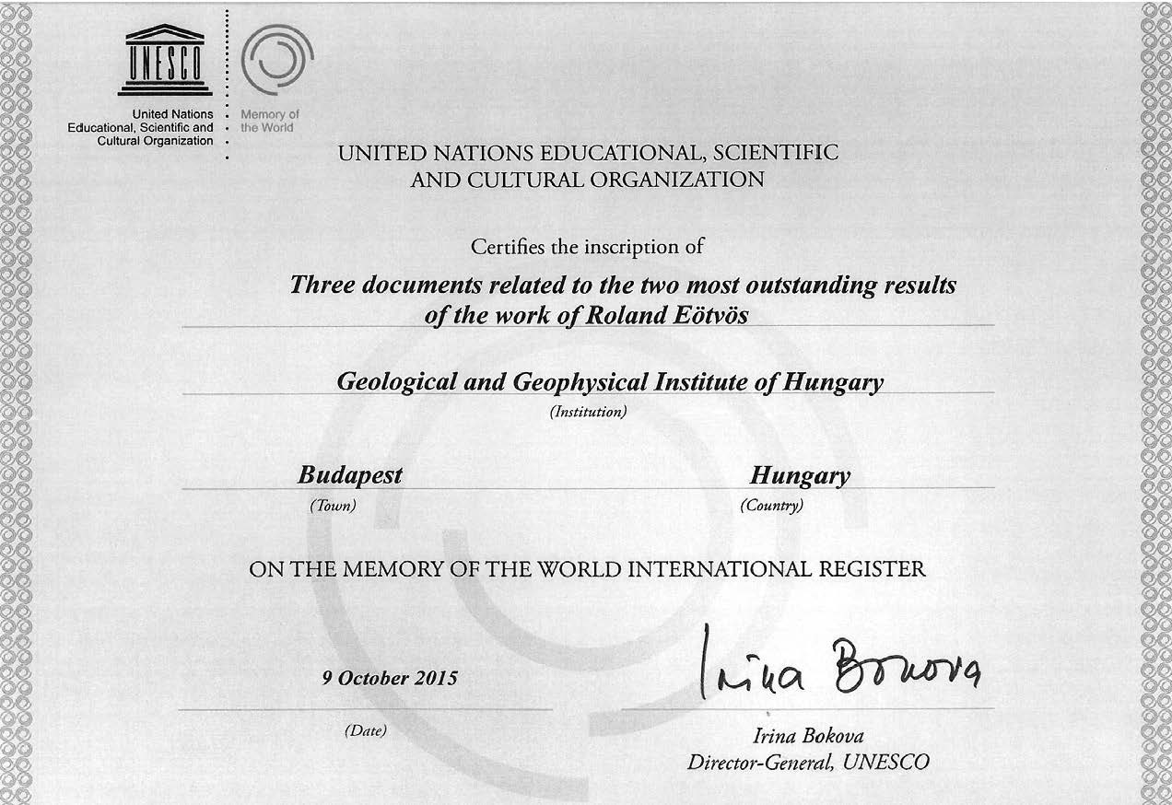
Certificate of the UNESCO

Slide 12

Thank you
for your attention

